Slide 1

Angular Project -FitPro

Slide 2
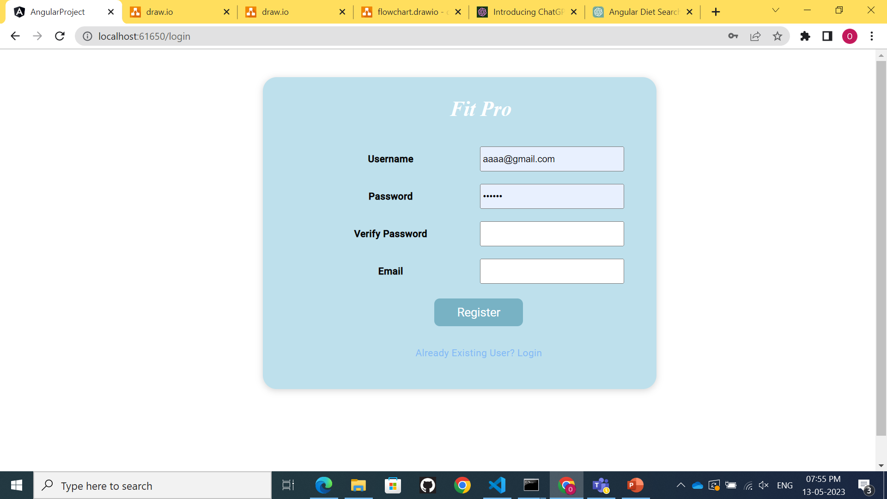
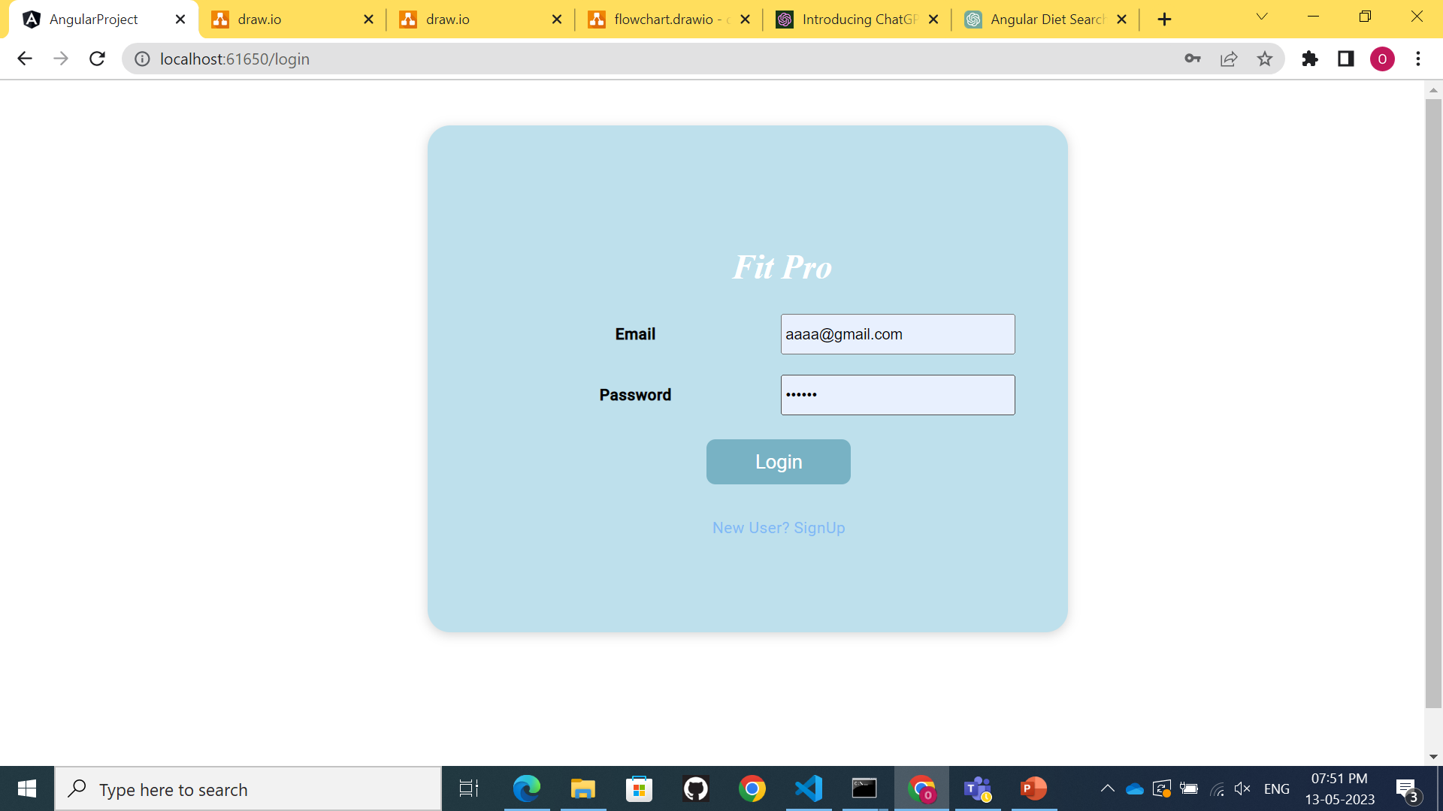
Login page Material module-toolbar,toggle,card sign in –template based approach sign up-template based approach lazy loading validation http get method http post method

Slide 3
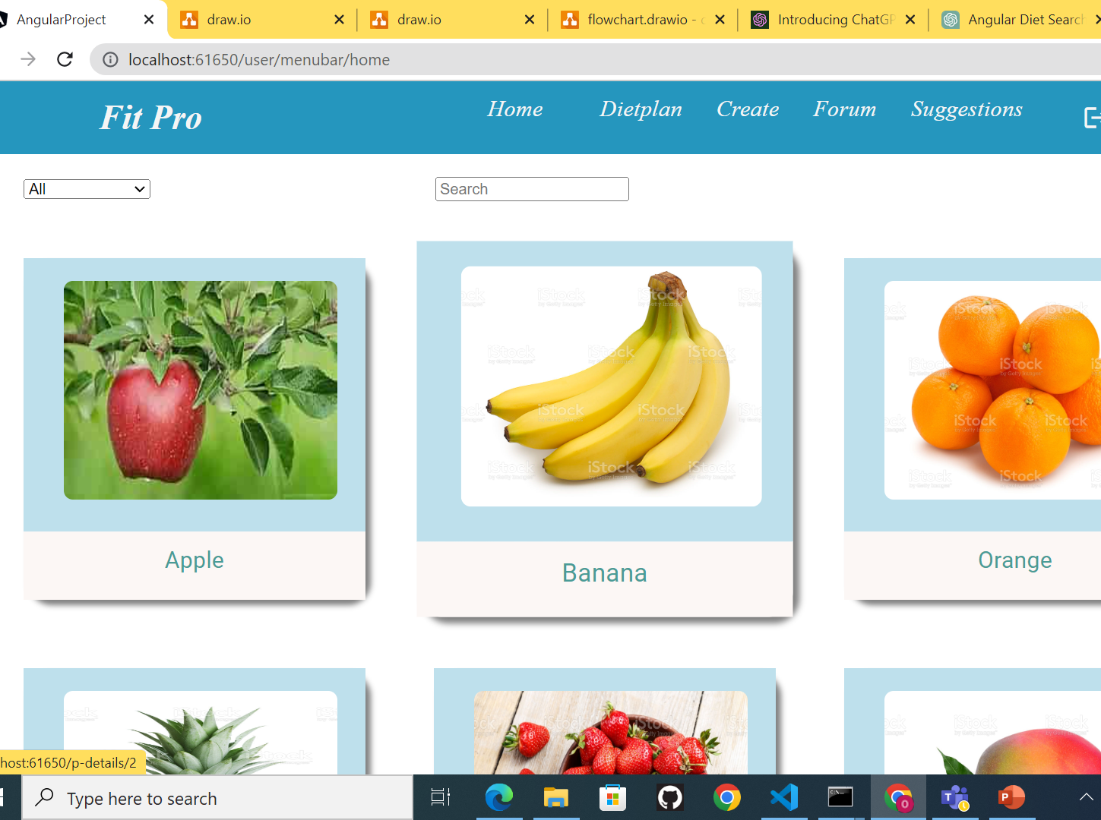
User Home Page
.Http get method
Type filter
Search bar using function
Internationalization
Router navigation
‘

Slide 4
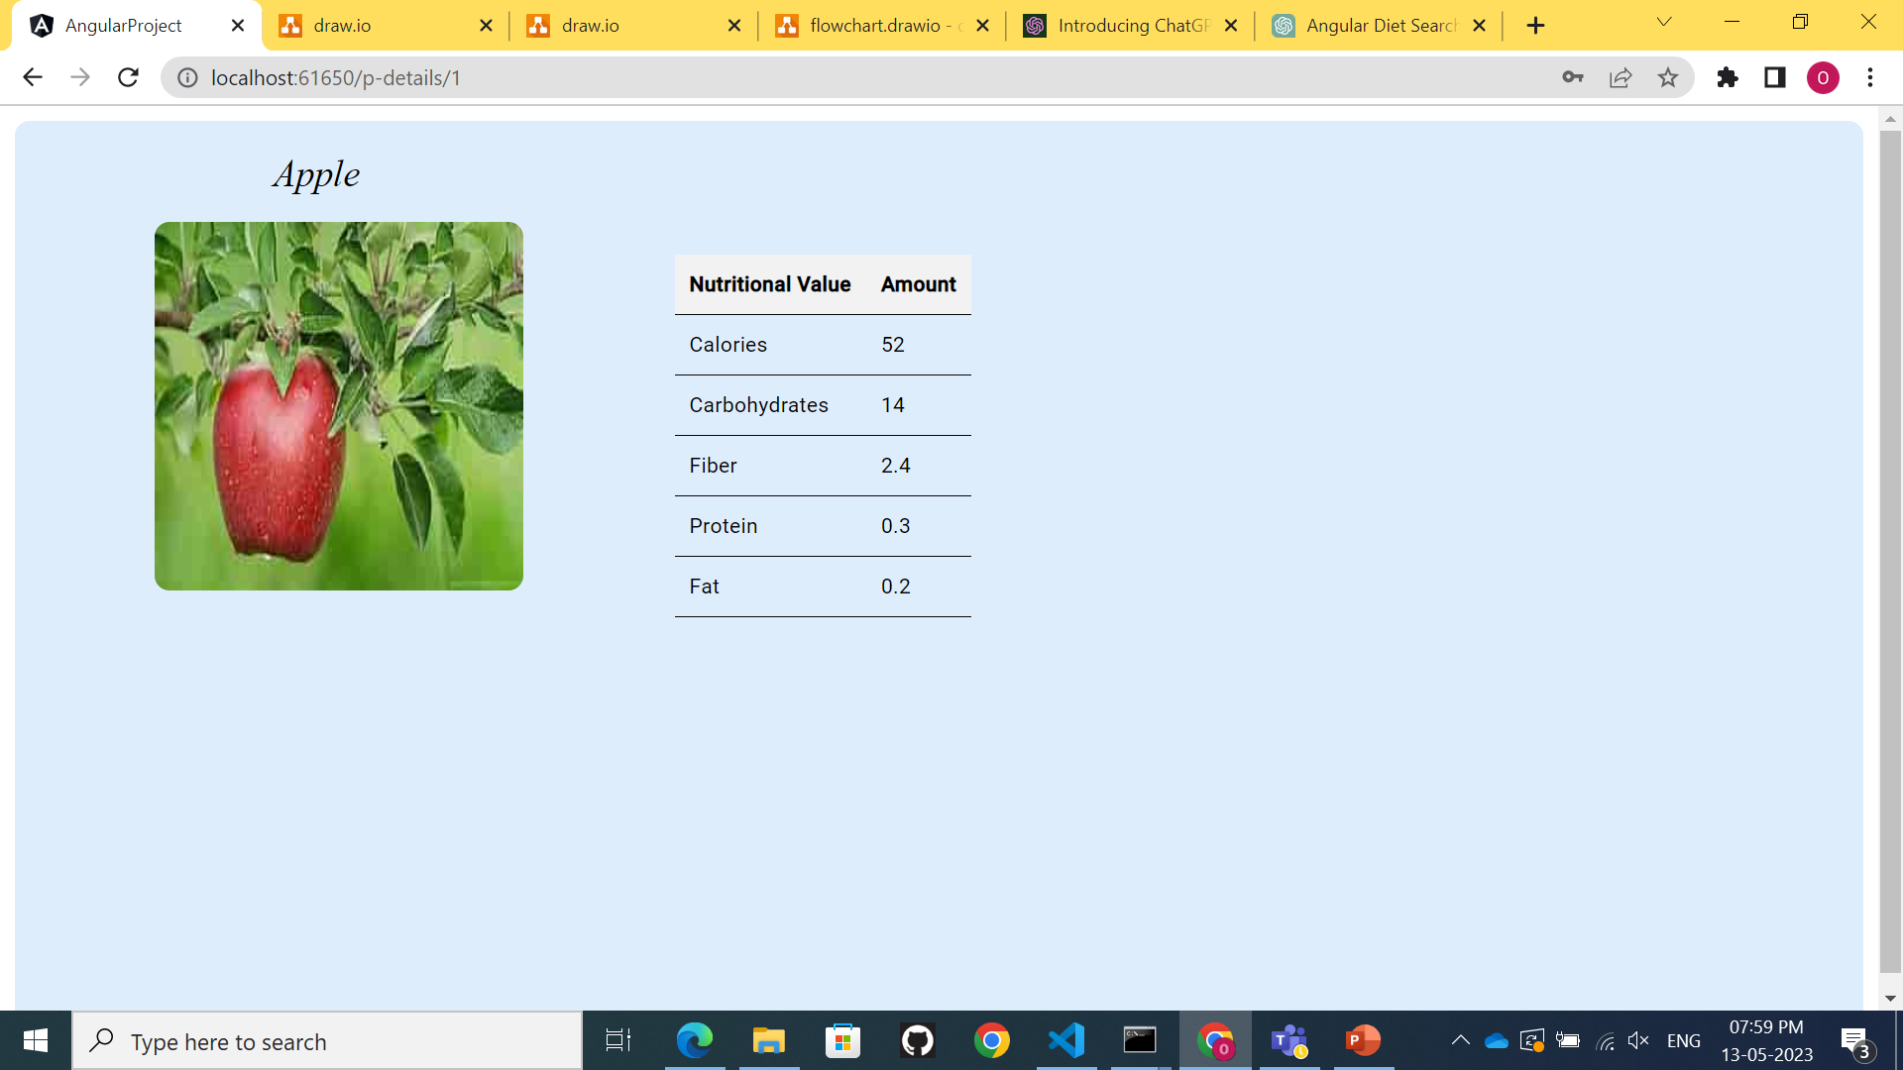
Product details component .HTTP get method .displayed nutrietion chart of product

Slide 5
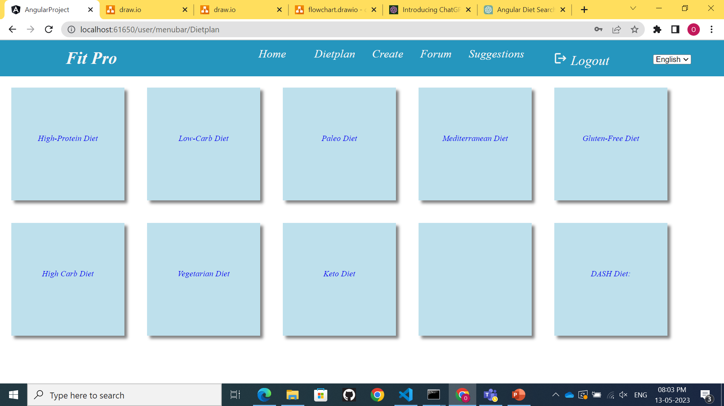
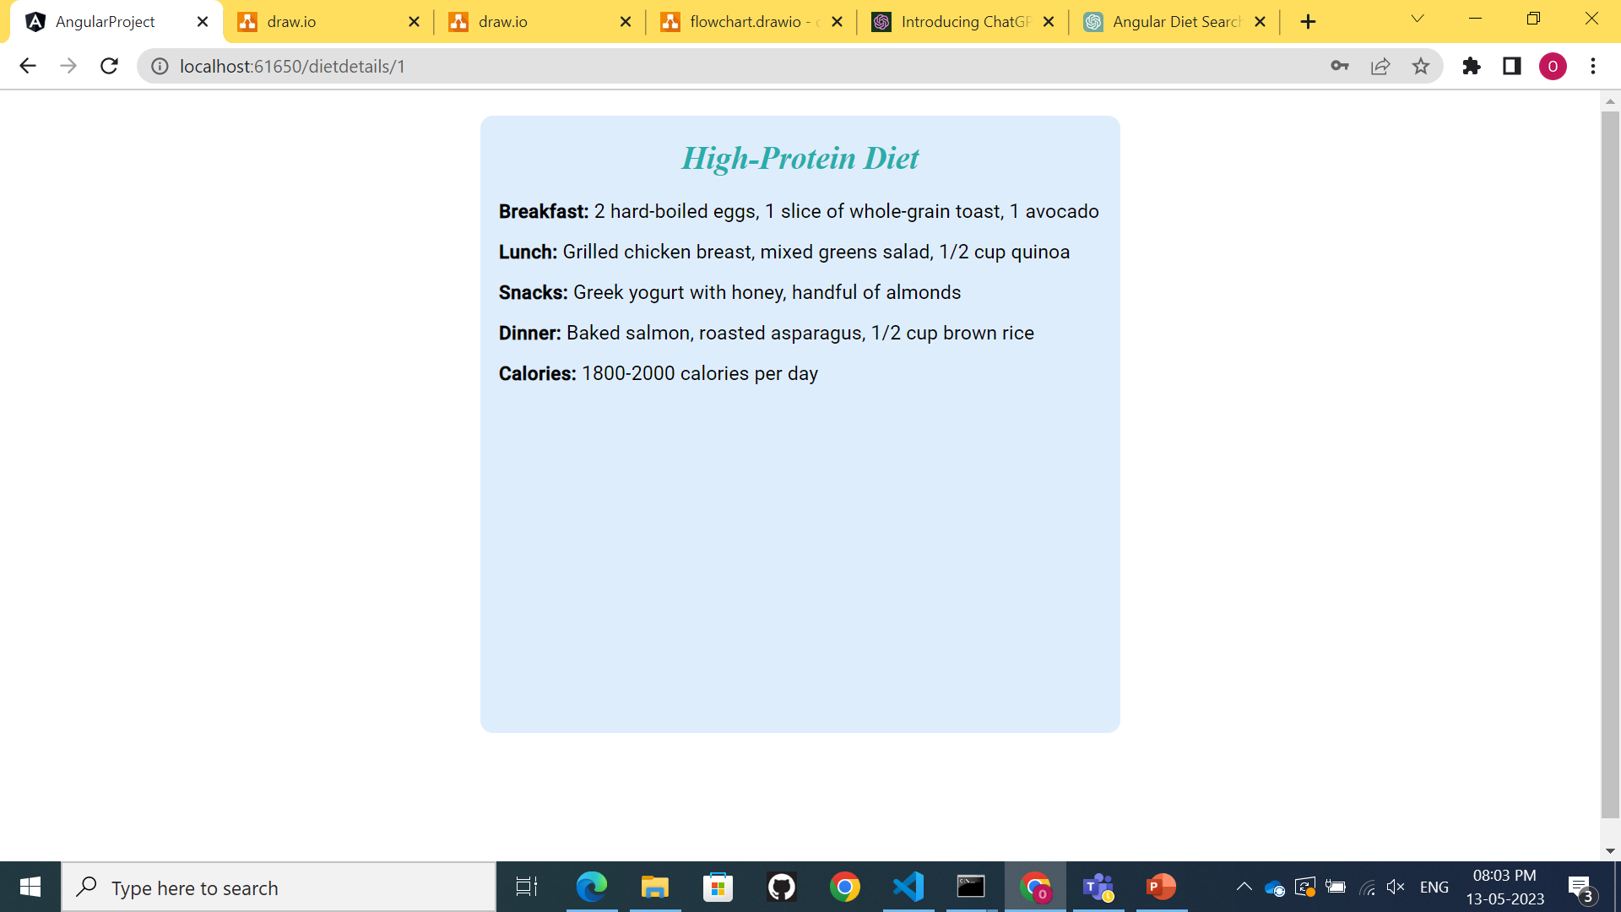
Diet Plan component .HTTP get Method diet details component .HTTP get method

Slide 6
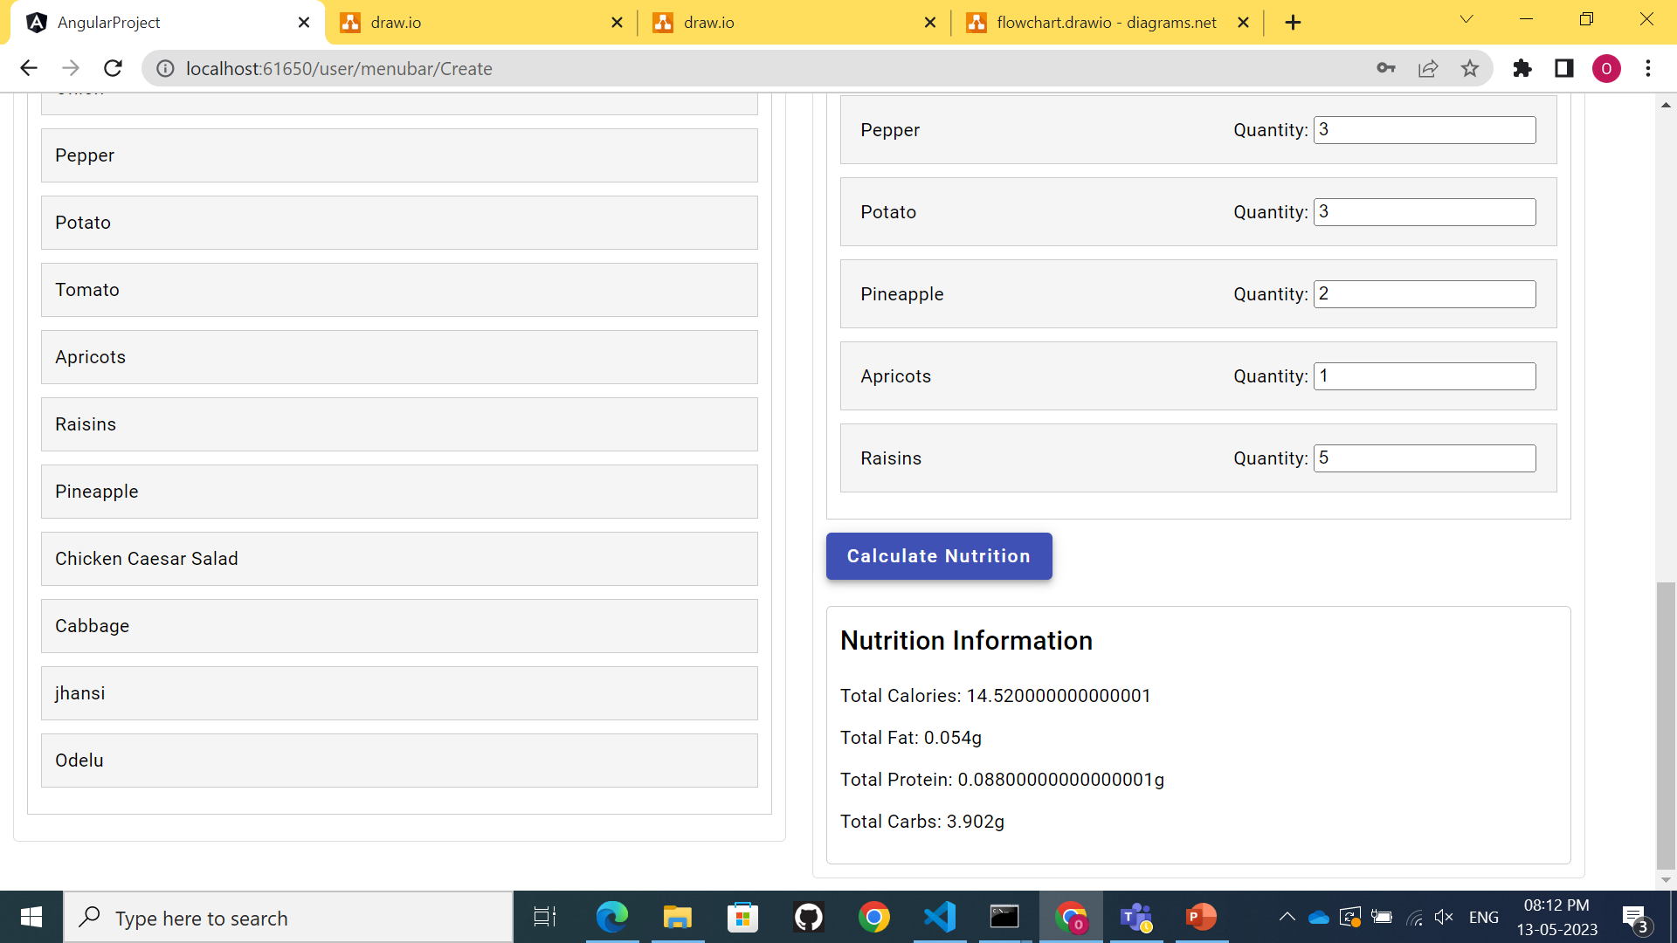
Create Component .used drag and drop module .HTTP get method .functions for calculating nutrition

Slide 7
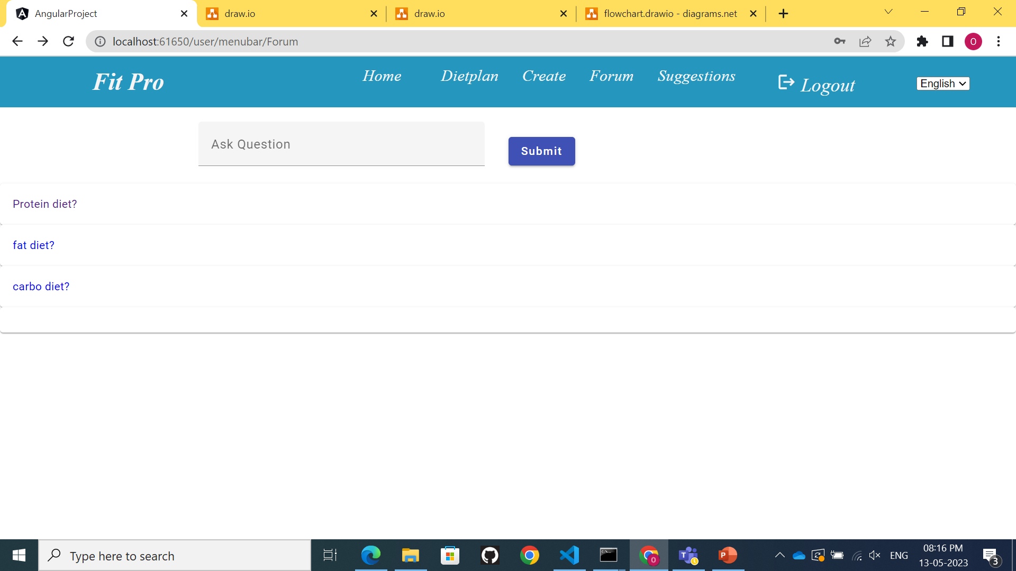
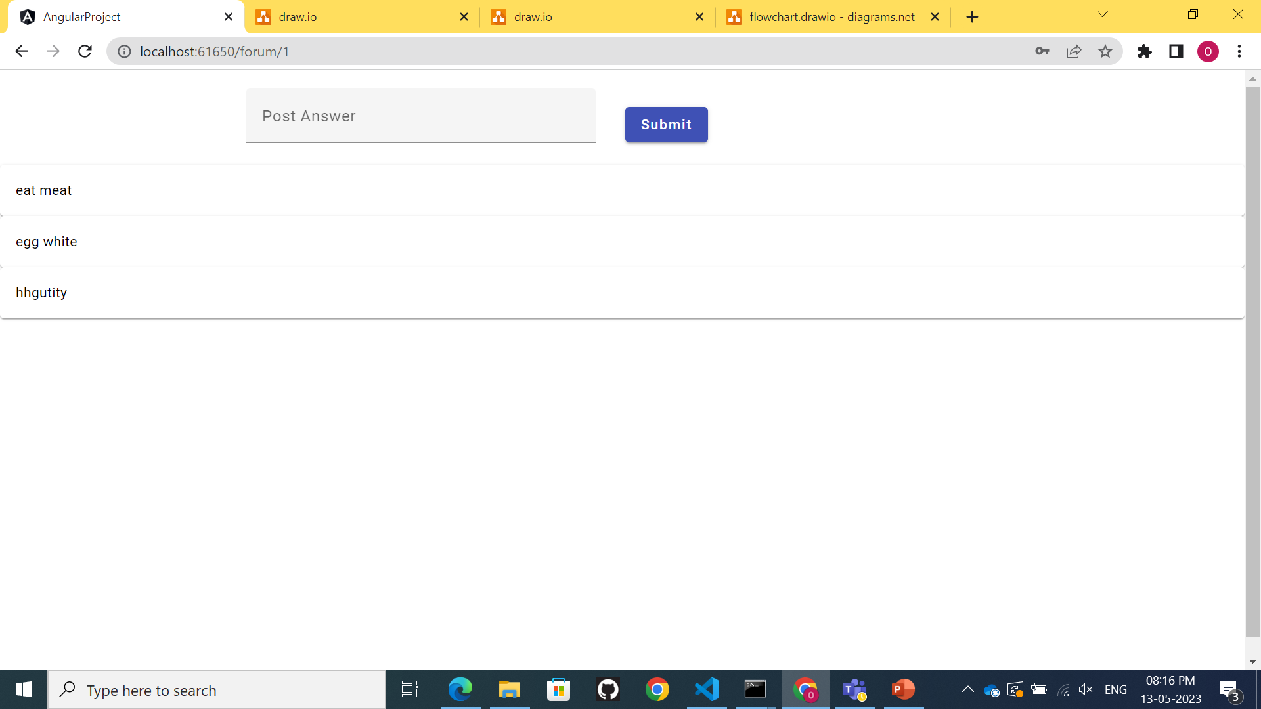
Forum Component .HTTP post method .HTTP get method user can post the question Forum response component user and admin can post the answer .HTTP get method .HTTP post method

Slide 8
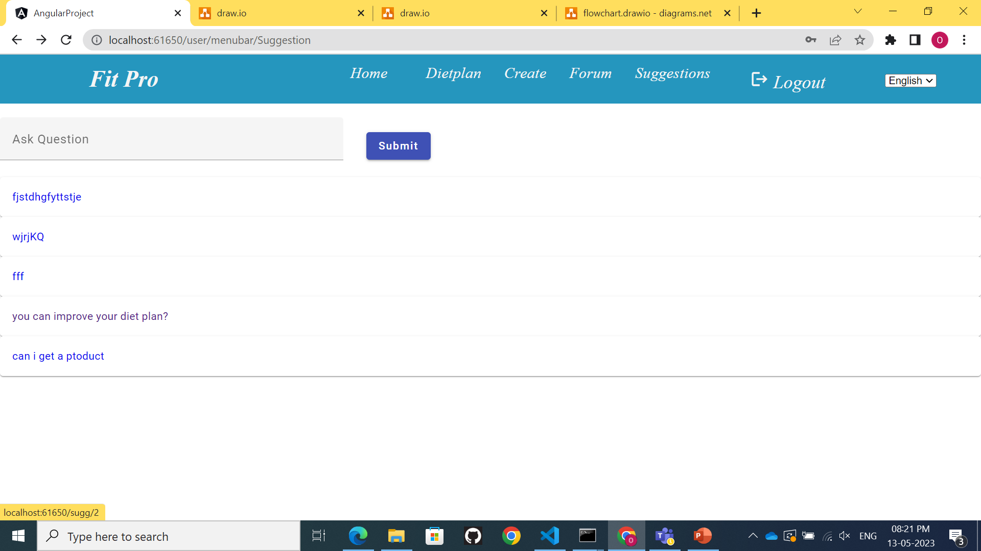
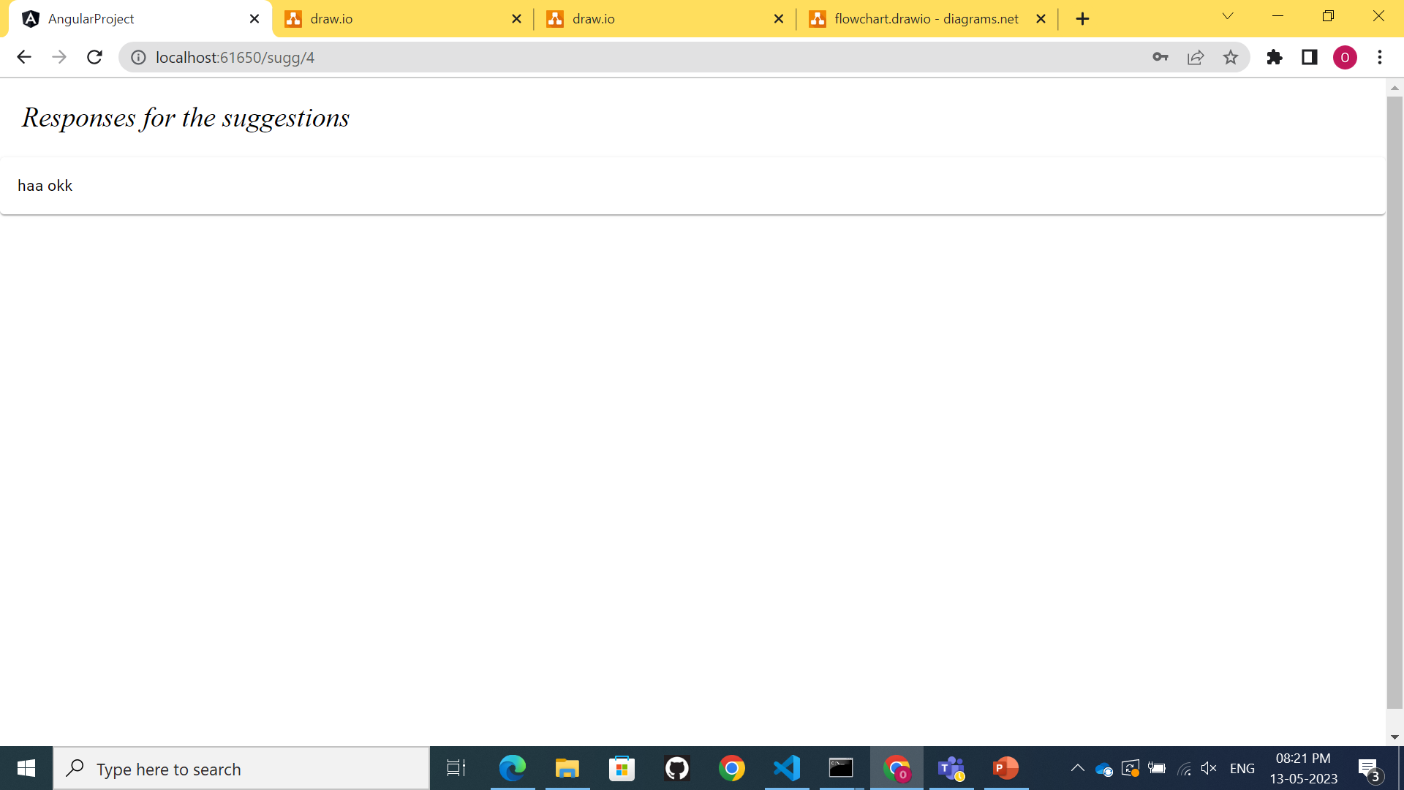
Suggestions Component .HTTP get method .HTTP post method User suggestion questions displayed Suggestion response Component . admin responses displayed here http get method

Slide 9
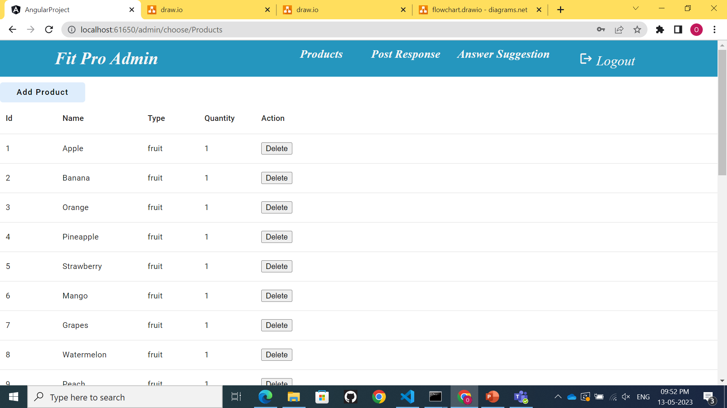
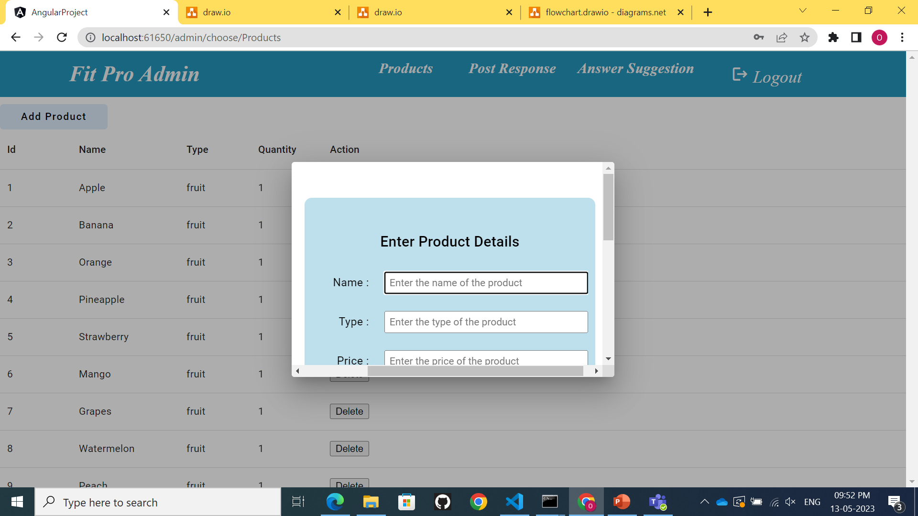
Admin side product component .HTTP get method .HTTP post method .HTTP delete method Add Product Component .Admin can add product the which will display in user and admin side .HTTP post method

Slide 10
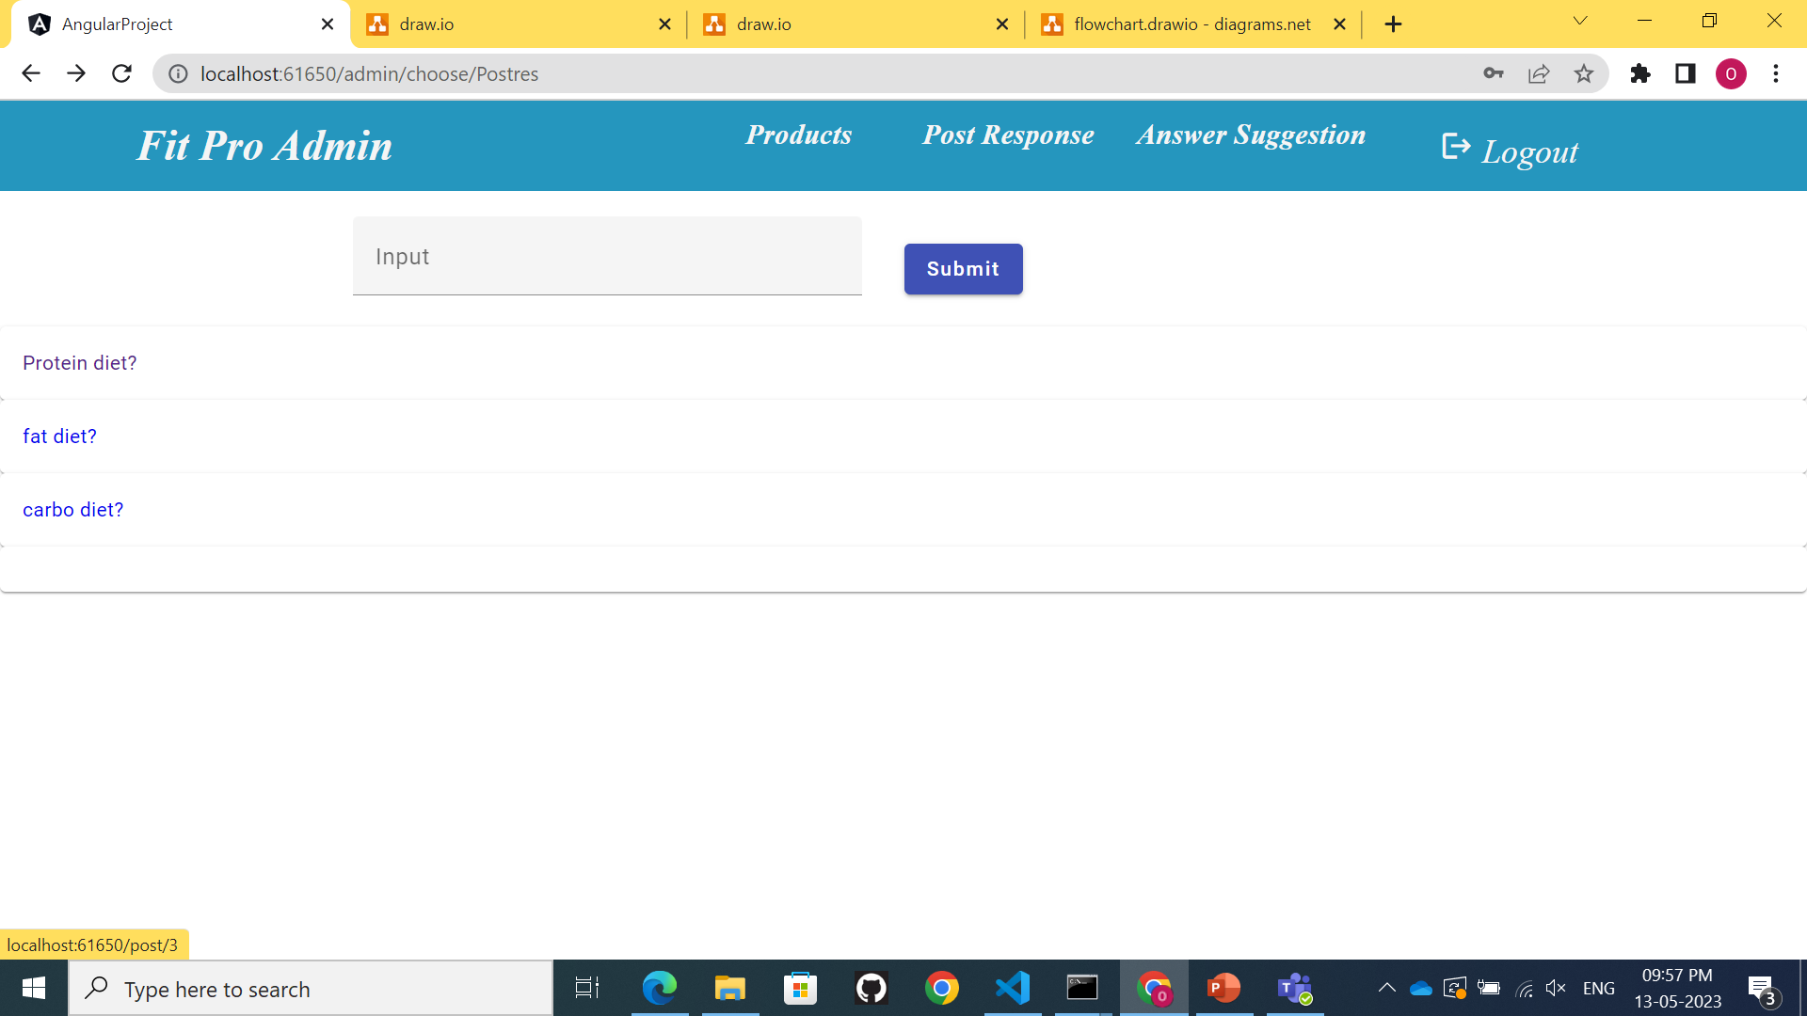

Post component .it displays the questions posted by user in forum .HTTP get method .HTTP post method post response component .HTTP get method HTTP post method

Slide 11
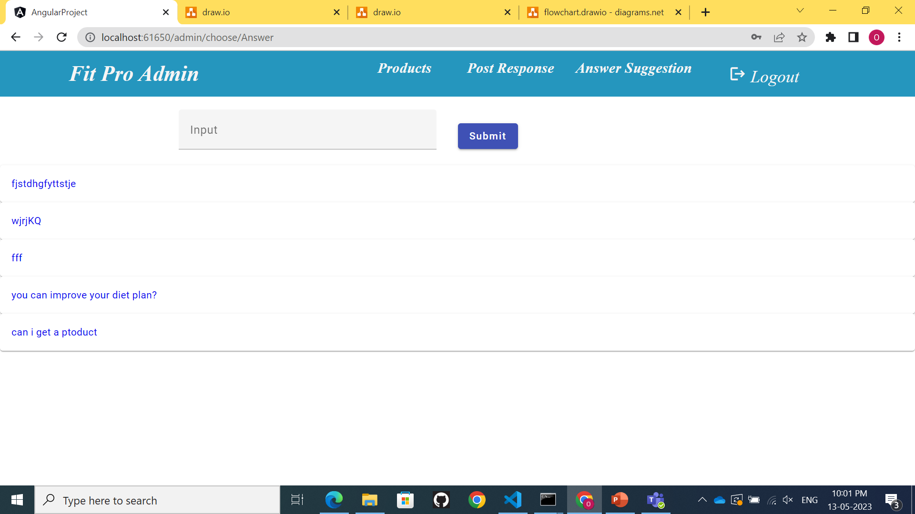
Answer Suggestion Component .HTTP get method .HTTP post method answer response component .Http get method http post method provides answers for the user questions

